Slide 1
Advanced Therapy Medicinal Products: the role of Pharmacy
Anne Black
Regional QA Specialist Pharmacist – NE & N Cumbria
Pan UK Pharmacy Working Group for ATMPs - Chair

Slide 2

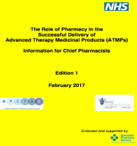

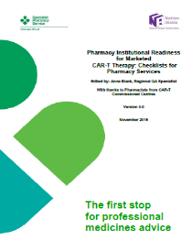


Pharmacy’s ATMP Journey
Reg 1394/2007
Governance
Clinical Trials
MA Products
Pan UK Pharmacy WG
Horizon Scanning/Commissioning
Pharmacy Institutional Readiness
Workforce Planning
Education

Slide 3


Advanced Therapy Medicinal Products
An ATMP is a biological medicine.
Regulation (EC) No 1394/2007 classified ATMPs as:
    Somatic Cell Therapy Medicinal Product (CTMP)
    Tissue Engineered Products (TEP)
    Gene Therapy Medicinal Product (GTMP)
(or any combination of the 3)

Slide 4
Somatic Cell Therapy Medicinal Products
Somatic cell therapy medicinal product means a biological medicinal product which has the following characteristics:
contains or consists of cells or tissues that have been subject to substantial manipulation so that biological characteristics, physiological functions or structural properties relevant for the intended clinical use have been altered, or of cells or tissues that are not intended to be used for the same essential function(s) in the recipient and the donor;
Is presented as having properties for, or is used in or administered to human beings, with a view to treating, preventing or diagnosing a disease through the pharmacological, immunological or metabolic action of its cells or tissues.

Slide 5
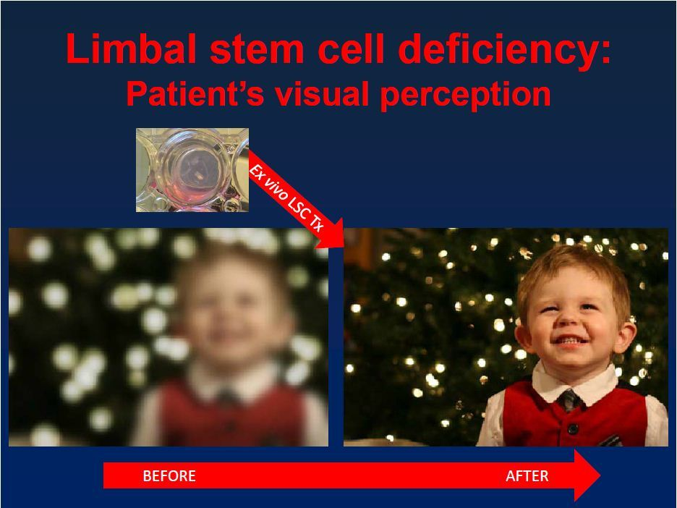

Slide 6

Autologous
GMP Batch of 1
Manufactured

Slide 7











Allogeneic
Donor
GMP Batch >1
Manufacture
Cell Bank

Slide 8
Gene Therapy Medicinal Products
Gene therapy medicinal product means a biological medicinal product which has the following characteristics:
It contains an active substance which contains or consists of a recombinant nucleic acid used in or administered to human beings with a view to regulating, repairing, replacing, adding or deleting a genetic sequence;
It’s therapeutic, prophylactic or diagnostic effect relates directly to the recombinant nucleic acid sequence it contains, or to the product of genetic expression of this sequence.
[Directive 2009/120/EC amending Directive 2001/83/EC]
Notes:
Example for authorised product: Glybera® (uniQure biopharma B.V.)
Caution: differentiate between ex vivo and in vivo gene therapy medicinal products!

Slide 9
Two Types of Gene Therapy
In Vivo
The vector is injected directly into a tissue where it is taken up by cells, or given intravenously
e.g. Talimogene Laher parepvec (imlygic - MA)
Ex Vivo
A sample of cells are taken and the vector is used to introduce the gene to the starting material cells
e.g. CAR-T Therapy

Slide 10
What is CAR-T Cell Therapy
Patient-specific (autologous) cell therapies
Patient’s own T lymphocytes - genetically modified to express a chimeric antigen receptor to confer antigen specificity
Genetic modification by manufacturer
  Using viral vector derived from a retrovirus or a lentivirus, which carries the new gene for the chimeric receptor
Notes:
Chimeric antigen receptor T cells, so-called CAR-T, are the leading anti-cancer cell therapy in the world at present. These are regulated as medicines in the EU, specifically as somatic cell therapy Advanced Therapy Medicinal Products (ATMPs). CAR-T are generally patient-specific (autologous) cell therapies and consist of the patient’s own T lymphocytes which are genetically modified to express a chimeric antigen receptor to confer antigen specificity. The genetic modification is conducted by the manufacturer using a viral vector derived from a retrovirus or a lentivirus which carries the new payload gene for the chimeric receptor.

Slide 11
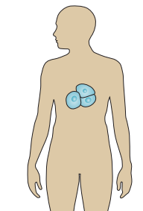
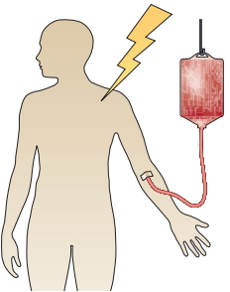
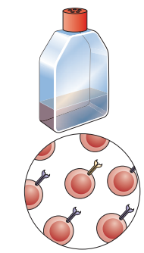
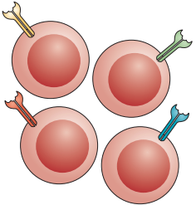



CAR-T
Infuse ATMP in pre-conditioned patient
Manage toxicity
Blood taken from patient
CAR-T Treatment Cycle
T Cells isolated from blood product
Expand cell populations in culture
Viral vector encoding for tumour-specific CAR
Human T cell engineered to express tumour-specific CAR

Slide 12
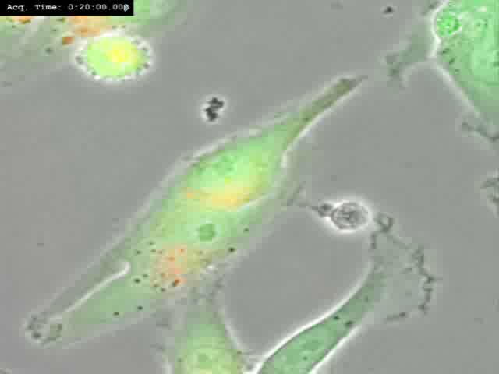
Notes:
So, what is it that we wish Therapeutics NE to do,
Support closing the 2 translation gaps
Early discovery to initial clinical research
And adoption at scale into routine clinical practice
Perhaps described as “Supporting early stage development to clinical adoption”
And to do that we require Industry, academia and healthcare providers to work together.

Slide 13
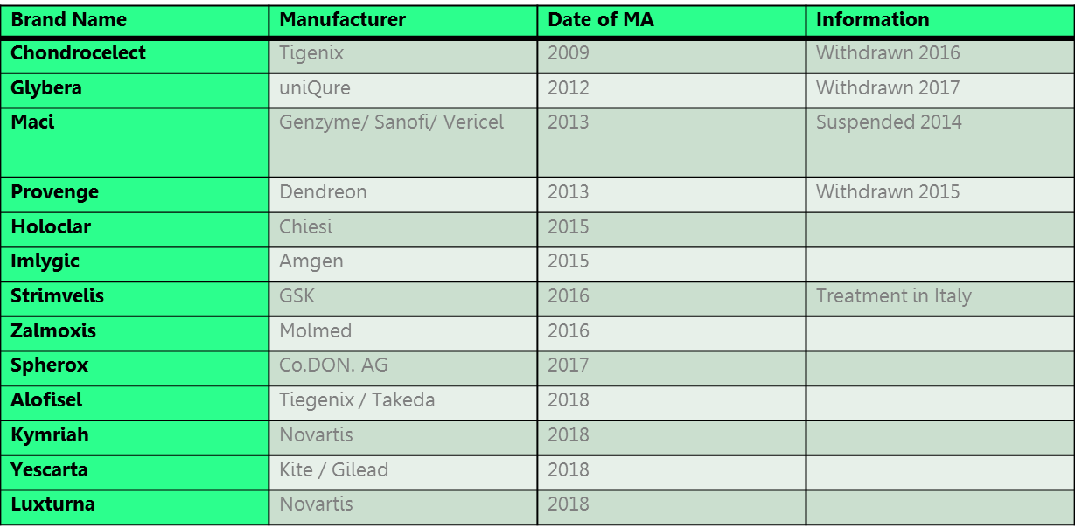
ATMPs holding
Marketing Authorisations

Slide 14

Pharmacy Institutional Readiness for Marketed CAR-T Therapy: Checklists for Pharmacy Services Edited by: Anne Black, Regional QA Specialist With thanks to Pharmacists from CAR-T Commissioned Centres Version 3.0 November 2018
The first stop
for professional
medicines advice
Notes:
CAR-T have been in development at multiple academic centres for over 15 years and multiple iterations have been developed and tested. Current commercial CAR-T available from Novartis (Kymriah) and Gilead (Yescarta) are both “second generation” CAR-T in which the payload in the lentivirus consists of an antibody binding site specific to CD19 plus a T cell co-stimulatory domain and an intracellular domain to initiate signalling in the T cell. The CAR-T cells all carry the same receptor so, unlike conventional T cells, they are all specific for the same antigen. These products have been licensed in the USA during 2017 and are expected to be receiving central EU authorisation during 2018.
At present the two commercial CAR-T both target the CD19 antigen which is expressed on all B lymphocytes and B lymphocyte precursors. This means they target B cell tumours such as B-ALL and many B cell lymphomas. However, many other tumour antigens are being targeted by novel CAR-T in numerous clinical trials although they are predominantly targeted to haematological malignancies at present due to difficulties in delivering CAR-T into solid tumours.
Hospital pharmacists are likely to be faced with CAR-T as licensed medicines in the near future but should also be prepared to support commercial and academic clinical trials of novel CAR-T and this briefing document aims to address all scenarios.

Slide 15
Patient Journey
In-Patient
Day Case
Professional
Bridging
Chemo
Pre-Conditioning
In-patient
Oncology
Administration
Cytokine
Release
Syndrome
Consent
Neurological
Apheresis
Centre
ICU Toxicity
Management
Clinical Area Oncology
+ 10 days
Home
Leukapheresis
Serology

Slide 16
Product Journey
Stem Cell
Lab
Clinical Area
Defrost
Receipt &
Verification for
Patient
Manufacturing
Centre
Clinician Ready
to Administer
Storage
Selection
Cryopreservation
Stem Cell
Lab
In-patient
Oncology
Administration
Packaging
Procurement
of the
Starting
material
Apheresis
Centre

Slide 17
Combined Journey
Stem Cell
Lab
In-Patient
Clinical Area
Defrost
Day Case
Professional
Bridging
Chemo
Receipt &
Verification for
Patient
Pre-Conditioning
Manufacturing
Centre
Clinician Ready
to Administer
Storage
Selection
Cryopreservation
Stem Cell
Lab
In-patient
Oncology
Administration
Packaging
Cytokine
Release
Syndrome
Procurement
of the
Starting
material
Consent
Apheresis
Centre
Neurological
ICU Toxicity
Management
Clinical Area Oncology
+ 10 days
Home
Leukapheresis
Serology

Slide 18
Clinical
Commissioned Centre
Operational
Governance

Slide 19
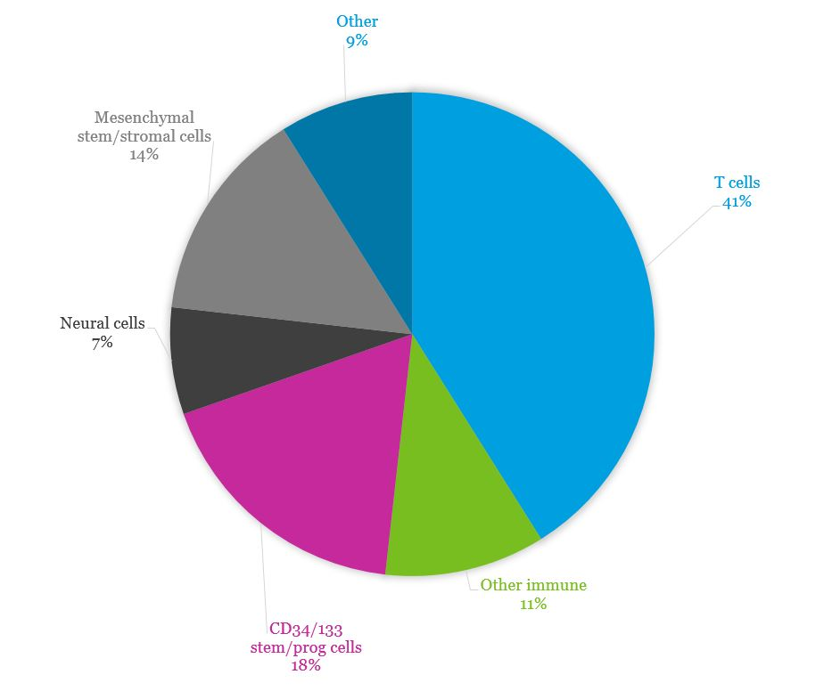
The CAR-T Revolution?

Slide 20
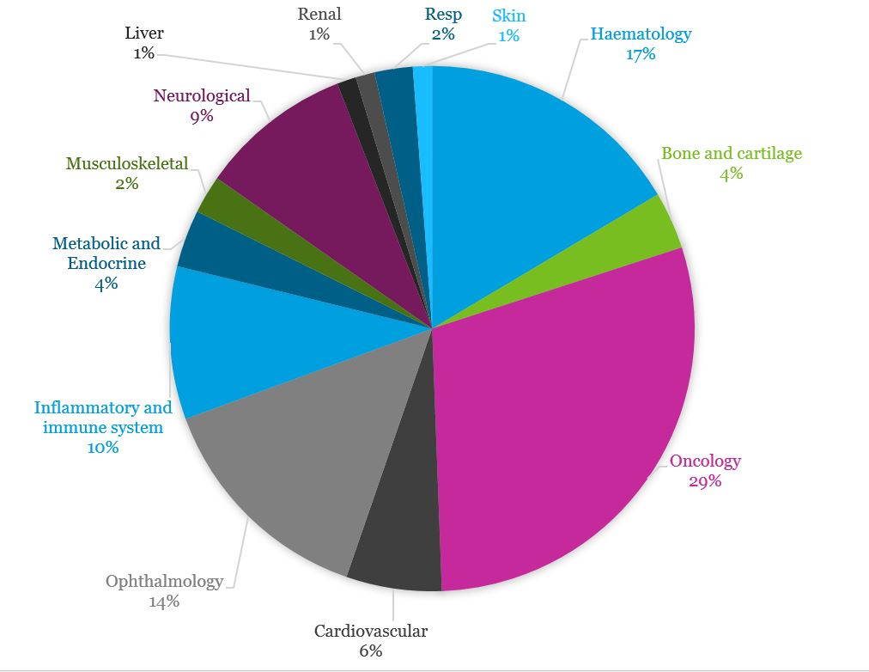
Distribution of UK cell and gene therapy clinical trials according to therapeutic area in 2018
Data from Cell and Gene Therapy Catapult Clinical databases

Slide 21

NHS SPS Horizon
Scanning for Marketed Products
Approximately:
66 products expected by 2024
11 – 12 for evaluation in 19/20
Invaluable Resource Prescribing Outlook with include an ATMP chapter

Slide 22


Developers Journey
Process Engineering/
Development
Research
Clinical Trials
Marketing Application
Manufacturing
What keeps patients safe?
Regulatory Controls: GMP & GCP
Clinical trials risks controlled if key stakeholders are engaged.

Slide 23



Implementation
Journey
Marketing Authorisations
NHS Implementation Set Up
Commissioning
NICE
NHSE
NHS Implementation Set Up
Routine Clinical Practice
- Patient Benefits
What keeps Patients Safe?
Less Clear – SPC?
Limited experience in NHS
High Risk Medicines – Governance Required

Slide 24
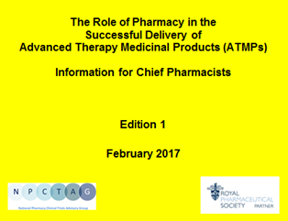
Medicines Management
Local Governance
                Other Aspects
                Communication
                Interfaces
                Primary Care
                Media

Slide 25
Licensed Medicines
Medicines Management
Clinical Trials
Unlicensed Medicines

Slide 26
Financial
High cost drugs
Licensed
CAR-T
Therapy
Committees
Medicines Management
Drug & Therapeutics
New Interventional Procedure Committee
Access to Drugs Process
Regulatory
HTA (JACIE) MHRA

Slide 27
Novel Medicine
Pharmacovigilance
  Yellow card scheme
Unlicensed Aspects
Autologous
ATMP
Medicine Management
High Cost Drug
Financial monitoring
Bespoke Therapy
Deviations
Cancellations
Recalls

Slide 28
Organisational Policies
How to Assure Governance is Appropriate
Local Procedures
Quality Systems
Collaboration & Communication

Slide 29
Clinicians
Primary Care
Apheresis
Collaboration
Stem Cell Laboratory
Referral Centres
Pharmacy
ITU
Companies

Slide 30
Practical Aspects of Medicines Management
Approval of the Order
Pharmacy Aseptics Service
Apheresis & Manufacture
Pharmacy Operational
Administration & Monitoring
Product Receipt
Preparation
Storage
Issue & Transportation to the Clinical Area

Slide 31
Practical Aspects of Medicines Management
Patient Verification
Pharmacy Aseptics Service Liaison
Order Approval?
Clinical Pharmacy
Patient
Monitoring
Referral Centre Liaison
Preparation/Supervision
Stem Cell Lab Liaison
Toxicity Management

Slide 32
Pan UK Pharmacy
Working Group for ATMPs
Continuously improve information to and safe and optimal implementation of ATMPs for patients
39 Pharmacists
3 Subgroups - Clinical/Operational
- Clinical Trials
- Regulatory
18 work streams including:

Slide 33
Pan UK PWG for ATMPs
Draft National SOP templates covering: toxicity management and supporting meds for ATMPs.
Out of specification ATMPs and their use as unlicensed medicines.
Draft document with a high-level view on legal requirements for Pharmacist Supervision of ATMPs.
Produce guidance on governance requirements and preparation facilities required for the provision of gene therapy in healthcare establishments.

Slide 34
Pharmacy Institutional Readiness for Marketed CAR-T Therapy: Checklists for Pharmacy Services Edited by: Anne Black, Regional QA Specialist With thanks to Pharmacists from CAR-T Commissioned Centres Version 3.0 November 2018
The first stop
for professional
medicines advice
Notes:
CAR-T have been in development at multiple academic centres for over 15 years and multiple iterations have been developed and tested. Current commercial CAR-T available from Novartis (Kymriah) and Gilead (Yescarta) are both “second generation” CAR-T in which the payload in the lentivirus consists of an antibody binding site specific to CD19 plus a T cell co-stimulatory domain and an intracellular domain to initiate signalling in the T cell. The CAR-T cells all carry the same receptor so, unlike conventional T cells, they are all specific for the same antigen. These products have been licensed in the USA during 2017 and are expected to be receiving central EU authorisation during 2018.
At present the two commercial CAR-T both target the CD19 antigen which is expressed on all B lymphocytes and B lymphocyte precursors. This means they target B cell tumours such as B-ALL and many B cell lymphomas. However, many other tumour antigens are being targeted by novel CAR-T in numerous clinical trials although they are predominantly targeted to haematological malignancies at present due to difficulties in delivering CAR-T into solid tumours.
Hospital pharmacists are likely to be faced with CAR-T as licensed medicines in the near future but should also be prepared to support commercial and academic clinical trials of novel CAR-T and this briefing document aims to address all scenarios.

Slide 35
Pan UK Pharmacy Working Group for ATMPs Gene Therapy Medicinal Products Governance and Preparation Requirements
Version 1 September 2019 With special thanks to Scottish Pharmacy Quality Assurance Group And Northern Alliance Advanced Therapy Treatment Centre
The first stop
for professional
medicines advice
Notes:
CAR-T have been in development at multiple academic centres for over 15 years and multiple iterations have been developed and tested. Current commercial CAR-T available from Novartis (Kymriah) and Gilead (Yescarta) are both “second generation” CAR-T in which the payload in the lentivirus consists of an antibody binding site specific to CD19 plus a T cell co-stimulatory domain and an intracellular domain to initiate signalling in the T cell. The CAR-T cells all carry the same receptor so, unlike conventional T cells, they are all specific for the same antigen. These products have been licensed in the USA during 2017 and are expected to be receiving central EU authorisation during 2018.
At present the two commercial CAR-T both target the CD19 antigen which is expressed on all B lymphocytes and B lymphocyte precursors. This means they target B cell tumours such as B-ALL and many B cell lymphomas. However, many other tumour antigens are being targeted by novel CAR-T in numerous clinical trials although they are predominantly targeted to haematological malignancies at present due to difficulties in delivering CAR-T into solid tumours.
Hospital pharmacists are likely to be faced with CAR-T as licensed medicines in the near future but should also be prepared to support commercial and academic clinical trials of novel CAR-T and this briefing document aims to address all scenarios.

Slide 36
Impact of Future Role
Collaboration beyond Pharmacy boundaries
Education of wider Pharmacy workforce
  Clinical Pharmacy Team
  Clinical Trials Team
  Medicines Management Team
  QA/QP/Technical Services Team
Future workforce considerations
MI Specific
  Horizon Scanning
  Liaison with Pan UK PWG for queries

Slide 37

Conclusion
ATMPs are Exciting for Patients and for NHS
Getting it Right First Time requires Organisational Governance and
System Leadership

Slide 38
Thank you for listening
Email: Anne.Black7@nhs.net

